Slide 1

Google Cloud Platform
Python scope in GCP

Slide 2
What is Google Cloud Platform (GCP)?
Google Cloud Platform is a set of Computing, Networking, Storage, Big Data, Machine Learning and Management services provided by Google that runs on the same Cloud infrastructure that Google uses internally for its end-user products, such as Google Search, Gmail, Google Photos and YouTube.
So before looking into the details of Google Cloud Platform, Let’s understand Cloud Computing First.

Slide 3
What is Cloud Computing?
Cloud computing is the on-demand delivery of compute power, database storage, applications, and other IT resources through a cloud services platform via the internet with pay-as-you-go pricing. It is the use of remote servers on the internet to store, manage and process data rather than a local server or your personal computer.
Cloud computing allows companies to avoid or minimize up-front IT infrastructure costs to keep their applications up and running faster, with improved manageability and less maintenance, and that it enables IT teams, to adjust resources rapidly to meet fluctuating and unpredictable demand.

Slide 4
Cloud-computing providers offer their services according to different models, of which the three standard models per NIST (National Institute of Standards and Technology ) are :
Infrastructure as a Service (IaaS)
Platform as a Service (PaaS), and
Software as a Service (SaaS)

Slide 5
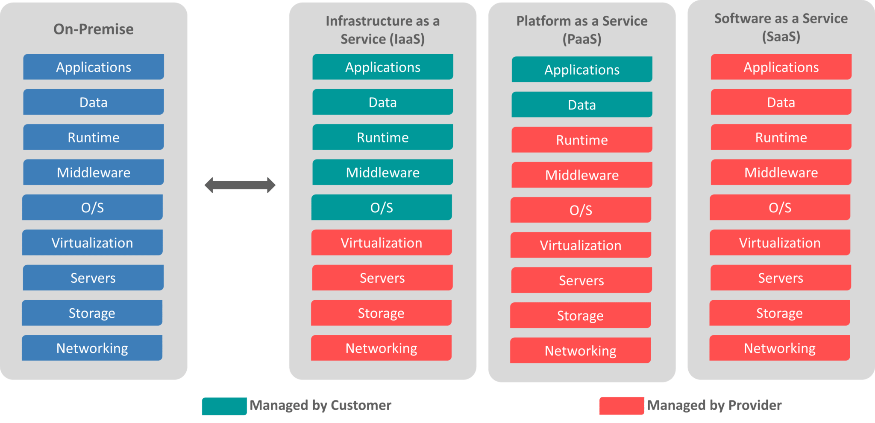

Slide 6
Why Google Cloud Platform?
Now that you have a brief idea of What is Google Cloud Platform and Cloud Computing, let’s understand why one must go for it. Google Cloud Platform, is a suite of cloud computing services that run on the same infrastructure that Google uses internally for its end-user products, such as Google Search, Gmail, Google Photos and YouTube. We all know how big is the database of Gmail, Youtube and Google Search.
And I don’t think in the recent years, Google’s server has gone down. It’s one of the biggest in the world, so it seems an obvious choice, to trust them, Right?
So now look at some of the features of GCP what really gives it an upper hand over other vendors.

Slide 7
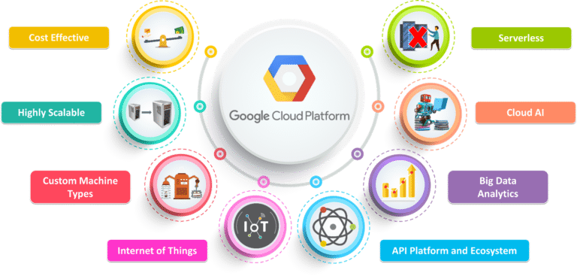

Slide 8
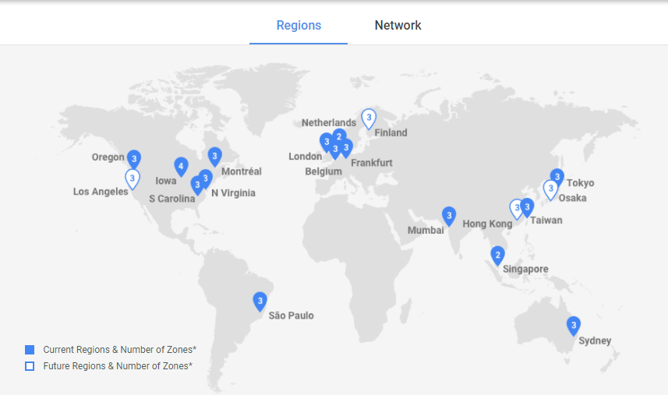
Google Cloud Platform Regions and Zones
Google Cloud Platform services are available in various locations across North America, South America, Europe, Asia, and Australia. These locations are divided into regions and zones. You can choose where to locate your applications to meet your latency, availability and durability requirements.
Here you can see that there is a total of 15
regions with at least 3 zones in every
region.

Slide 9
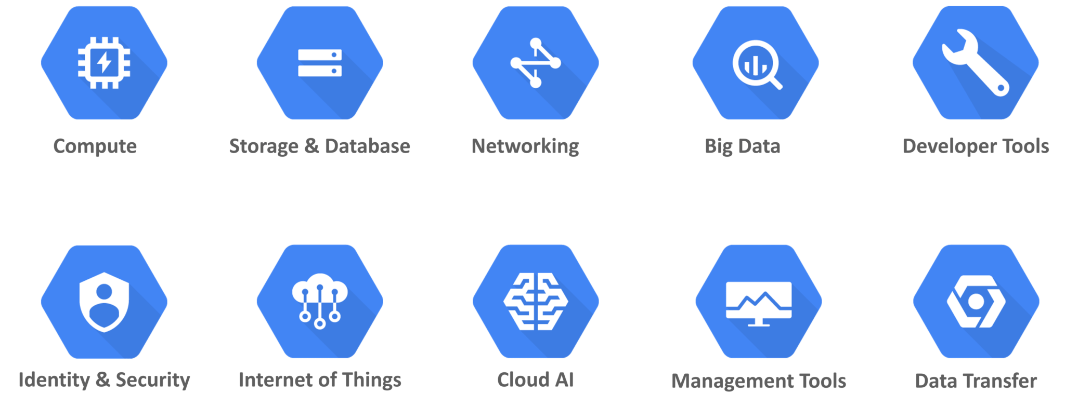
What are Google Cloud Platform (GCP) Services?
Google offers a wide range of Services. Following are the major Google Cloud Services:
Compute
Networking
Storage and Databases
Big Data
Machine Learning
Identity & Security
Management and Developer Tools

Slide 10
Compute
GCP provides a scalable range of computing options you can tailor to match your needs. It provides highly customizable virtual machines. and the option to deploy your code directly or via containers.
They are as follows:
1.Google Compute Engine
2.Google App Engine
3.Google Kubernetes Engine
4.Google Cloud Container Registry
5.Cloud Functions

Slide 11
Networking
The Storage domain includes services related to networking, it includes the following services
Google Virtual Private Cloud (VPC)
Google Cloud Load Balancing
Content Delivery Network
Google Cloud Interconnect
Google Cloud DNS

Slide 12
Storage and Databases
The Storage domain includes services related to data storage, it includes the following services
Google Cloud Storage
Cloud SQL
Cloud Bigtable
Google Cloud Datastore
Persistent Disk

Slide 13
Big Data
The Storage domain includes services related to big data, it includes the following services
Google BigQuery
Google Cloud Dataproc
Google Cloud Datalab
Google Cloud Pub/Sub

Slide 14
Cloud AI
The Storage domain includes services related to machine learning, it includes the following services
Cloud Machine Learning
Vision API
Speech API
Natural Language API
Translation API
Jobs API

Slide 15
Identity & Security
The Storage domain includes services related to security, it includes the following services
Cloud Resource Manager
Cloud IAM
Cloud Security Scanner
Cloud Platform Security

Slide 16
Management Tools
The Storage domain includes services related to monitoring and management, it includes the following services
Stackdriver
Monitoring
Logging
Error Reporting
Trace
Cloud Console

Slide 17
Developer Tools
The Storage domain includes services related to development, it includes the following services
Cloud SDK
Deployment Manager
Cloud Source Repositories
Cloud Test Lab

Slide 18
Creating a Free Account
Now that we have learnt What is Google Cloud Platform, To gain access to these Services, you need to just create a free account on GCP. You get $300 worth credit to spend it over a period of 12 Months. You need to provide your card details, but you won’t be charged extra after your trial period ends or you have exhausted the $300 credit
After you create an account. Go to Console.

Slide 19
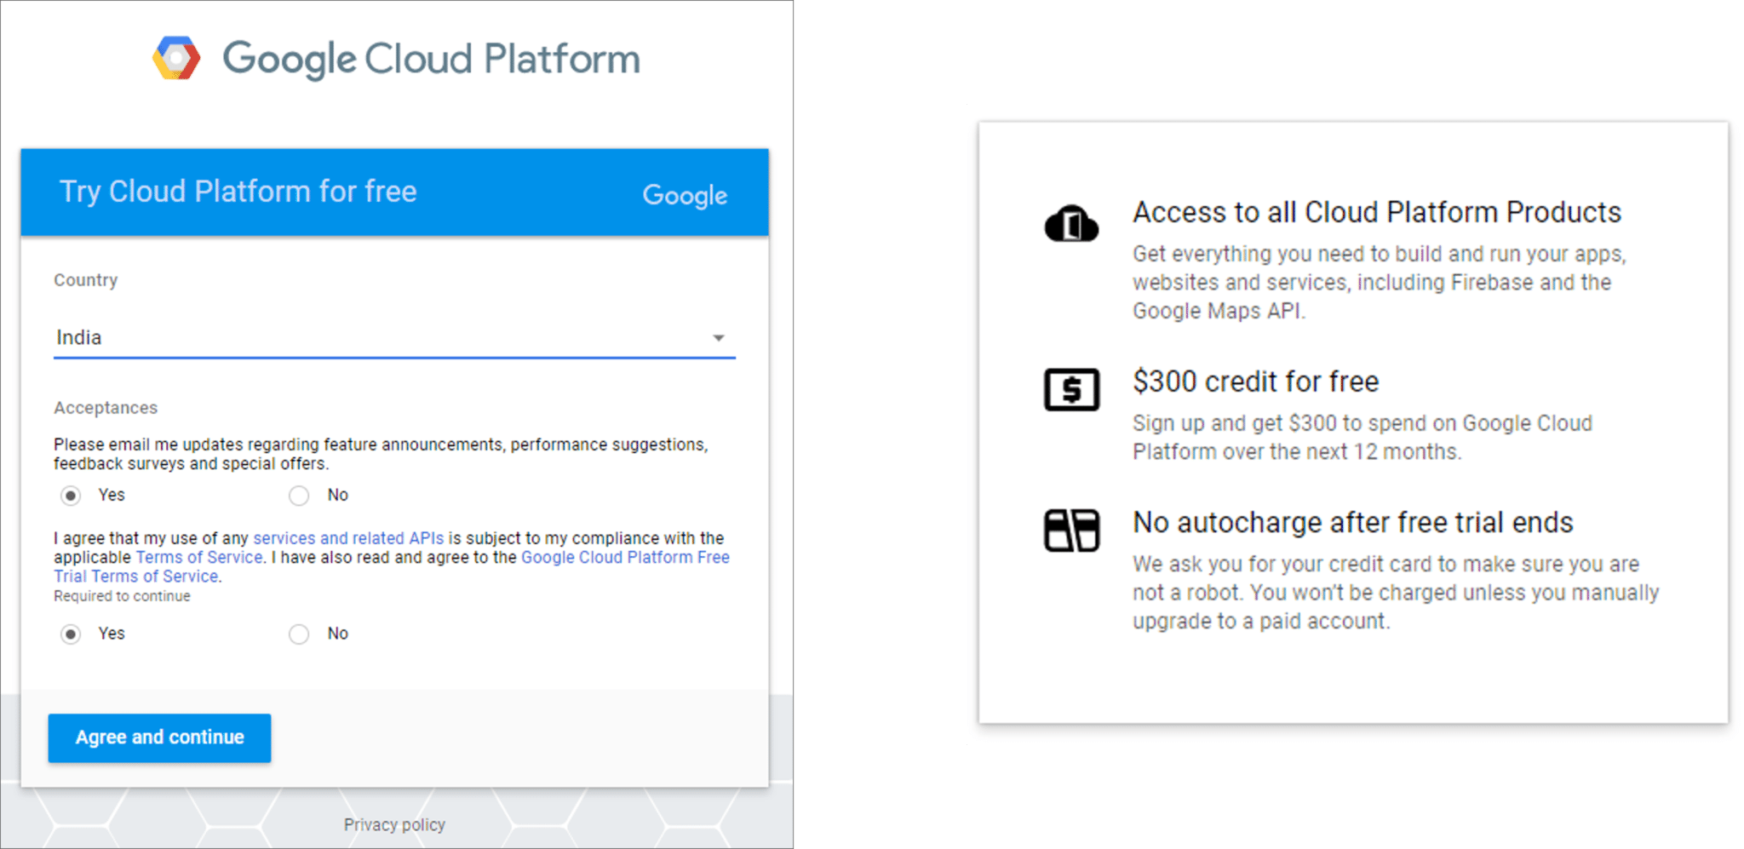

Slide 20
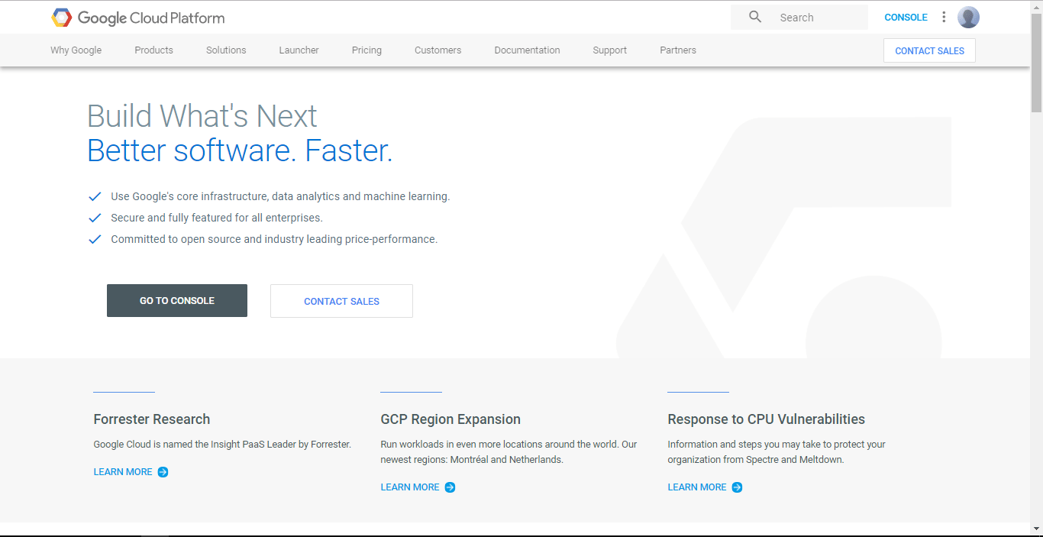
Here you will have a Dashboard which gives a summary of the GCP Services you are using, along with the Stats and Billing Report.

Slide 21
In this section of Google Cloud Platform, you can find the summarized view of the following
Project Info
Resources being used
Various API’s running
Compute Engine (CPU Usage %)
Google Cloud Platform Status
Billing of Services per Project
Error Reporting
Data Trace
Tutorials
News and Updates about Google Cloud Platform
Documentation

Slide 22
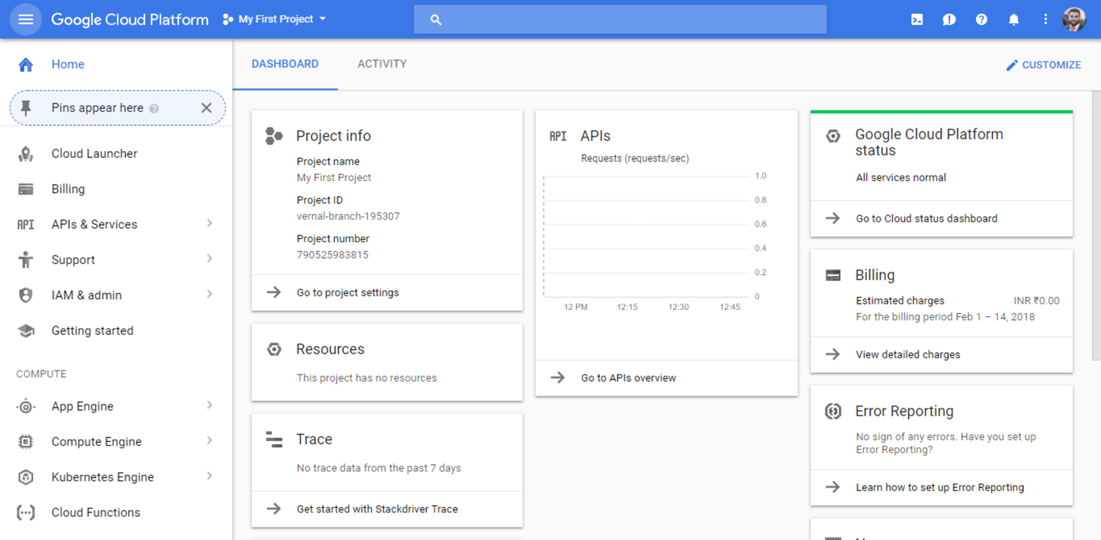

Slide 23
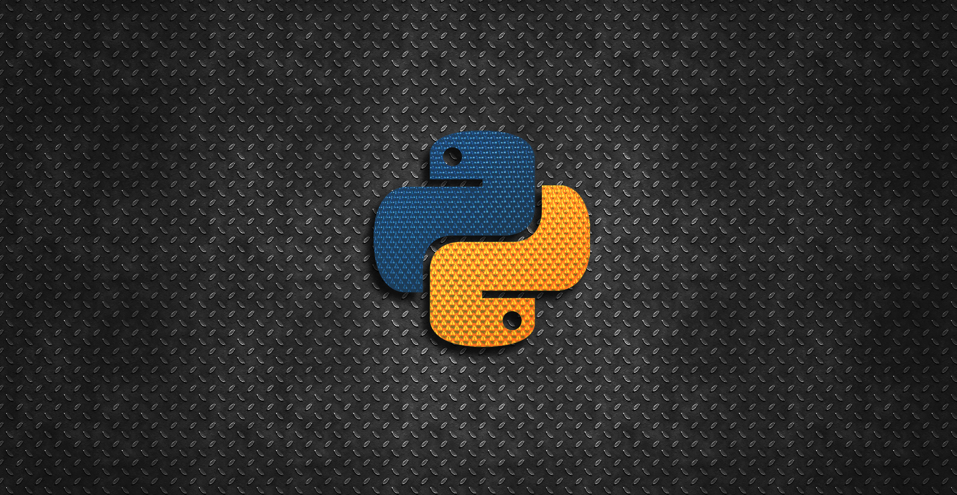
Scope of Python in GCP

Slide 24
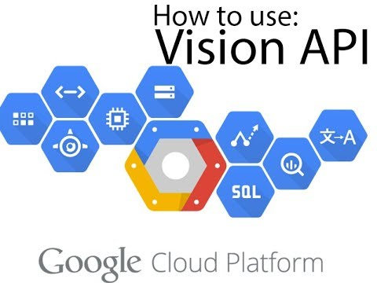
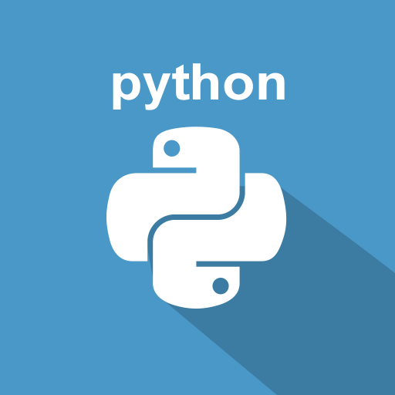
Powerful Image Analysis With Google Cloud Vision And Python
The scope of possibilities to apply Google Cloud Vision service is practically endless. With Python Library available, it can certainly help you bring out deeper interest in Machine Learning technologies.

Slide 25
How do I install Python on Google cloud?
To install the Python client library for Cloud Datastore:
Install the client library locally by using pip : pip install google-cloud-datastore.
Set up authentication. ...
Use the Cloud Datastore Client Libraries reference to implement support for the Cloud Datastore service in your app.

Slide 26
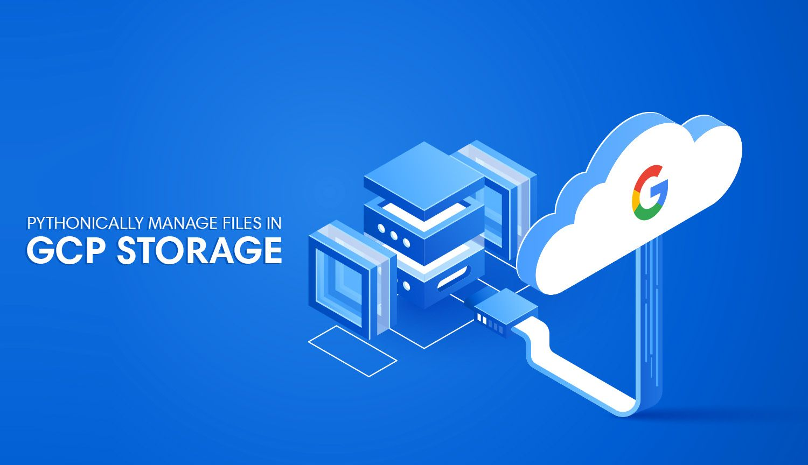
Google Cloud Storage is an
excellent alternative to S3 for
any GCP fanboys out there.
Google Cloud provides a
dead-simple way of interacting
with Cloud Storage via the
google-cloud-storage Python
SDK: a Python library
I've found myself preferring
over the clunkier Boto3 library.
We've actually touched on
google-cloud-storage briefly
when we walkedthrough
interacting with BigQuery programmatically, but there's enough functionality available inthis library to justify a post in itself.

Slide 27
Getting Set Up
Setting up a Google Cloud bucket is simple enough to skip the details, but there are a couple of things worth mentioning. First on ouSetting Bucket-level Permissions
Setting Bucket-level Permissions
Making buckets publicly accessible is a big no-no in the vast majority of cases; we should never make a bucket containing sensitive information public (unless you're a contractor for the US government and you decide to store the personal information of all US voters in a public S3 bucket - that's apparently okay). Since I'm working with memes which I've stolen from other sources, I don't mind this bucket being publicly accessible.
Bucket-level permissions aren't enabled on new buckets by default (new buckets abide by object-level permissions). Changing this can be a bit tricky to find at first: we need to click into our bucket of choice and note the prompt at the top of the screen:

Slide 28
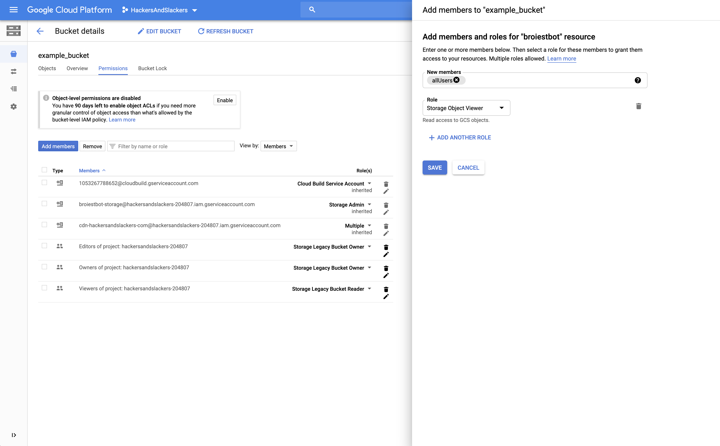
New buckets should prompt you for bucket-level permissions.
Clicking "enable" will open a side panel on the right-hand side of your screen. To enable publicly viewable files, we need to attach the Storage Object Viewer role to a keyword called allUsers (allUsers is a reserved type of "member" meaning "everybody in the entire world).

Slide 29
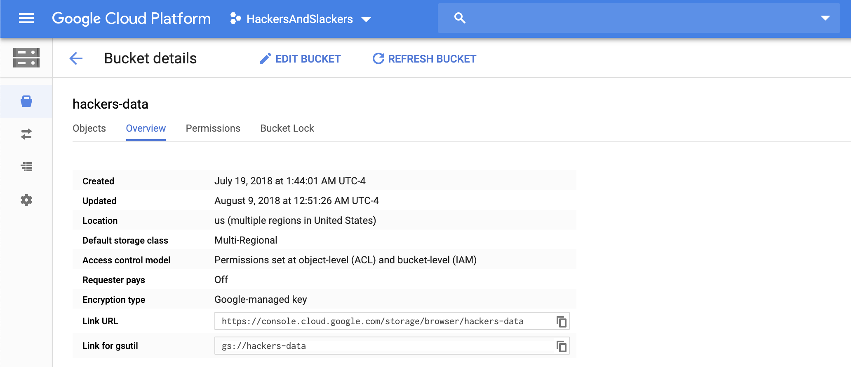
Finding Our Bucket Info
When we access our bucket programmatically, we'll need some information about our bucket like our bucket's URL (we need this to actually know where items in our bucket will be stored). General information about our bucket can be found under the "overview" tab, take this down
Generating a Service Key
Finally, we need to generate a JSON service
key to grant permissions to our script. Check
out the credentials page in your GCP console
and download a JSON file containing your
creds. Please remember not to commit this
anywhere.

Slide 30
What is Python used for at Google?
Originally Answered: What is python used for at Google?
Python is an official language at Google. Alongside two other prominent languages Java and C++. Google even supports the development of Python programming language and sponsors various Pyhon conferences like PyCon. Until 2012, the designer and creator of Python, Guido van Rossum was employed by Google when left to work for DropBox.
Well, coming to the question, Python is used at Google for its countless internal systems as well as:
Most of the core search algorithms at Google are written in Python and C++.
Various build systems, log analysis, code review tools etc are written in Python by Googlers.
Lots of Open Source libraries .
Various Data and API libraries like Google Data Python Client Library, Google APIs Client Library for Python and Google AdWords API Python Client Library.
YouTube : Previously it was written in PHP but eventually it was replaced by Python and the site uses Python heavily for various purposes like view video etc.
One of the main website for hosting for Google developers code.google.com as well.
And currently, most of the Machine Learning, AI as well as robotics projects at Google are implemented using Python and lots of C++.

Slide 31
Build system automation of all kinds (although the main build tool is in Java)
Test automation
Deployment automation
Many services configure their job placement and options with a Python-derived language
Monitoring configuration and dashboards
Data analysis using Scipy, Scikit, Numpy and various kinds of notebook UIs
Configuring Tensorflow and analysing the results of ML projects
Hundreds of little command-line utilities for all sorts of small code and data manipulations
Thousands of internal websites
The youtube.com site was still

Slide 32
How does Google use Python? In which process does it?
Google uses Python for processing the huge amount of data they acquire from their users.
For example:
How does Youtube know what to recommend to you? Randomly? No. Youtube gets access to your data such as your history of videos (and their tags perhaps), and by applying Machine Learning, it learns what kind of videos you like to watch. With every video you watch from their recommendation, it becomes better at “guessing”. Python is a great platform for Artificial Intelligence and all that implies, hence it is being used by Big Data processors like Youtube

Slide 33
How do you process an image in Python?
Let's get started
Step 1: Import the required library. Skimage package enables us to do image processing using Python. ...
Step 2 : Import the image. Once we have all the libraries in place, we need to import our image file to python. ...
Step 3 : Find the number of Stars. ...
Step 4 : Validated whether we captured all the stars.

Slide 34
Why Python is used for image processing?
Python is a general purpose programming language with a number of potential advantages for image handling and data presentation in nuclear medicine. ... These include numpy for the array manipulation needed in image processing, and matplotlib, for display of graphs and data plots.

Slide 35
Google vision API for image analysis with python
Google Vision API detects objects, faces, printed and handwritten text from images using pre-trained machine learning models. You can upload each image to the tool and get its contents. But, if you have a large set of images on your local desktop then using python to send requests to the API is much feasible.
This article talks about how to create, upload images to google bucket, perform label detection on a large dataset of images using python and google cloud sdk. “gsutil” is used for fast upload of images and set lifecycle on google bucket. All images were analyzed with batch processing.

Slide 36
Step 1: Create a project
Follow the steps in the link below to create a new project and enable google vision AI. Store the key in a JSON file.
Step 2: Download google cloud sdk along with gsutil
Gsutil tool helps easy upload of large dataset of images to a google bucket. Run the following code in command prompt or terminal
curl https://sdk.cloud.google.com | bash
Else you can also download sdk from following links
Mac OS: https://cloud.google.com/sdk/docs/quickstart-macos (store the folder in home directory)
Windows https://cloud.google.com/sdk/docs/quickstart-windows
Step 3: Set configuration:
Following commands are required to connect to your google cloud project created in step 1. Type this in terminal
gcloud init
Pick configuration to use: select “Create a new configuration”
Choose an account to perform operations: If you don’t see your gmail account select “Log in with a new account” and login to the account.
Pick cloud project to use: You should see the project you created in step 1 and select it

Slide 37
Step 4: Upload images to google cloud storage
Create a bucket: gsutil mb ‘gs://bucketname’ (bucket name should be unique)
Upload image folder from your local desktop to google bucket:
gsutil -m cp -R ‘path/to/imagefolder’ ‘gs://bucketname’
Step 5: Get labels for images in google bucket
Now that you have all the images in the bucket get labels using ‘ImageAnnotatorClient’. If you have a lot of images then iterating through every image in the bucket will be time consuming. Batch processing can speed up this process with a maximum limit of 16 images per batch (https://cloud.google.com/vision/quotas).
#install google cloud vision pip install google-cloud-vision#import dependencies from google.cloud import vision from google.cloud import storage from google.cloud.vision_v1 import enums from google.cloud.vision_v1 import ImageAnnotatorClient from google.cloud.vision_v1 import types import os import json
os.environ["GOOGLE_APPLICATION_CREDENTIALS"]='project_key.json' #(created in step 1)

Slide 38
# We can send a maximum of 16 images per request. start = 0 end = 16 label_output = []for i in range(int(np.floor(len(image_paths)/16))+1): requests = [] client = vision.ImageAnnotatorClient() for image_path in image_paths[start:end]: image = types.Image() image.source.image_uri = image_path requests.append({'image': image,'features': [{'type': enums.Feature.Type.LABEL_DETECTION}]}) response = client.batch_annotate_images(requests) for image_path, i in zip(image_paths[start:end], response.responses): labels = [{label.description: label.score} for label in i.label_annotations] labels = {k: v for d in labels for k, v in d.items()} filename = os.path.basename(image_path) l = {'filename': filename, 'labels': labels} label_output.append(l) start = start+16 end = end+16
#export results to JSON file with open('image_results.json', 'w') as outputjson: json.dump(label_output, outputjson, ensure_ascii=False)

Slide 39
Step 6: Delete images from google bucket:
You may want to delete the images once you are done with analysis as there will be storage costs. Deleting each image in a loop will take time. Instead set a lifecycle for the bucket so that you can delete whole bucket at once. Paste the following code in a JSON file and save it as lifecycle.json then execute the gsutil code
#Age tells about how many days after bucket creation you want to delete it.{ "rule": [ { "action": {"type": "Delete"}, "condition": {"age": 2} } ] }#This codes sets lifecycle for the bucket gsutil lifecycle set 'lifecycle.json' 'gs://bucket_name'
If you still have some questions or want to do text/face detection check out https://codelabs.developers.google.com/codelabs/cloud-vision-api-python/index.html?index=#0

Slide 40


